Slide 1


TRADE PROF
FINANCIAL INSIGHTS
10/03/2025
PREPARED FOR :
elites

Slide 2

TRADE PROF
Executive summary
The trade market has been highly volatile in recent years, requiring constant monitoring and analysis to predict bull and bear trends. Anchor companies are undergoing continuous transformation as they compete to lead the Fourth Industrial Revolution.
Trade Prof has recognized these signals and is prepared for both the changes and their aftereffects. AI has revolutionized industries such as marketing, gaming, technology, finance, and more, reshaping the global economic landscape
Many companies have continued with the status quo, leaving them behind in a rapidly evolving market, plagued by inefficiencies and human error.
To prevent this, this project analyzes the top 10 giants in the stock market listed on the S&P 500, Amazon, Apple, Nvidia, Google, GOOG, Meta, Microsoft, UnitedHealth, Tesla, and Berkshire Hathaway. It examines key financial indicators such as trade volume, dividends, stock splits, trade open and close prices, as well as market highs and lows.
This initiative marks a transformative step for Trade Prof, enhancing trading efficiency and enabling seamless, data-driven decision-making, even while asleep.

Slide 3

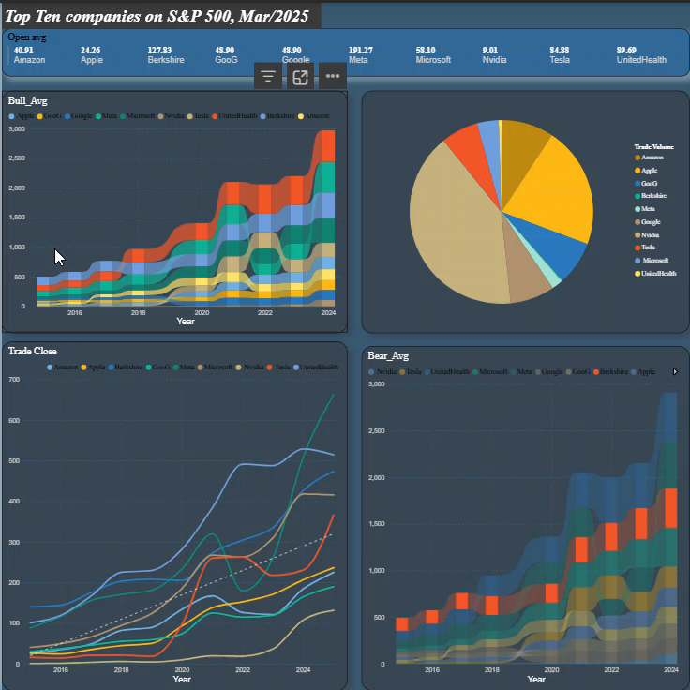
TRADE PROF
Findings
The findings show that UnitedHealth has the highest dividend payout, followed by Microsoft.
Additionally, UnitedHealth has led in trade losses since 2017 but retained second place in 2025, following Meta
Nvidia's market exhibits high volatility, likely driven by its groundbreaking innovations and globally impactful chip technology. The company's advancements, particularly in supercomputers, have attracted investors from around the world.
Apple has also remained a dominant force in trading, consistently leading in bull market value. The market experiences frequent spikes, a trend that has persisted since its inception

Slide 4
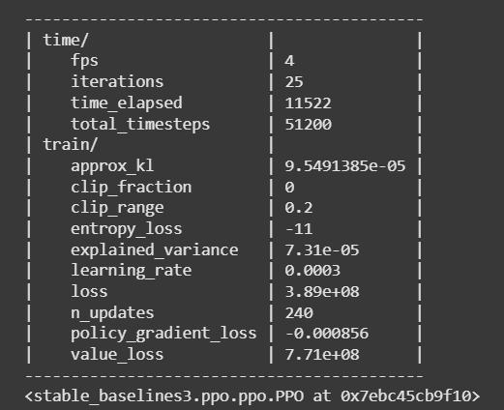
TRADE PROF
Conclusion
These market values are essential considerations when making trade decisions, as the data comes from reliable sources and is drawn from the inception of each company.
Regarding decision-making, Trade Prof has equipped AI engineers, data scientists, and engineers with the tools to develop an agentic AI model for algorithmic trading. This AI-driven approach enables automated trading based on historical patterns and market trends, enhancing efficiency and precision in financial decision-making.
This data has been trained, tested, and is ready for deployment to ensure optimal trading accuracy, continuous AI learning, and efficient market predictions.
The model was developed using Deep Reinforcement Learning, which has demonstrated superior forecasting capabilities compared to other AI approaches. Proximal Policy Optimization (PPO) served as the primary training method, enhancing the model’s adaptability and decision-making in dynamic market conditions

